Slide 1
CSS342 Data Structures, Algorithms, and Discrete Mathematics (I)

Slide 2
Goals by the end of this week (10/22, 10/24)
ADT: Stack, Queue (Tuesday)
Algorithms: recursion (Thursday)
Homework
Have your testing environment setup
No copy & paste from browser to IDE/Editor
Comfortable with CMake & Googletest
Midterm review
2nd session of Thursday class
Study group

Slide 3
Notes on homework 2

Slide 4
Linked List in-class lab 1
Given the head pointer (assuming with dummy head node)
Find the pointer to the N-th node from the end of the list
Head → 0 → 1 → 2 → 3 → 4 → 5 → end
N=7
N=4
N=2
N=1

Slide 5
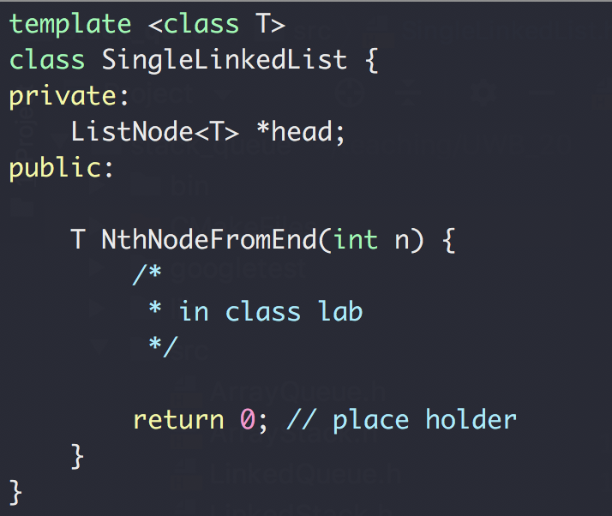
Linked List in-class lab 1
Given the head pointer (assuming with dummy head node)
Find the pointer to the N-th node from the end of the list

Slide 6
Linked List in-class lab 1
Given the head pointer (assuming with dummy head node)
Find the pointer to the N-th node from the end of the list
Head → 0 → 1 → 2 → 3 → 4 → 5 → end
p0
p1
p1
p1
N=4

Slide 7
Linked List in-class lab 1
Given the head pointer (assuming with dummy head node)
Find the pointer to the N-th node from the end of the list
2
Head → 0 → 1 → 2 → 3 → 4 → 5 → end
p0
p0
p1
p1
N=4
N=4

Slide 8

Linked List in-class lab 2
Given the head pointer (assuming with dummy head node)
Find whether the list has a loop
Head → 0 → 1 → 2 → 3 → 4 → 5
7
7
6

Slide 9
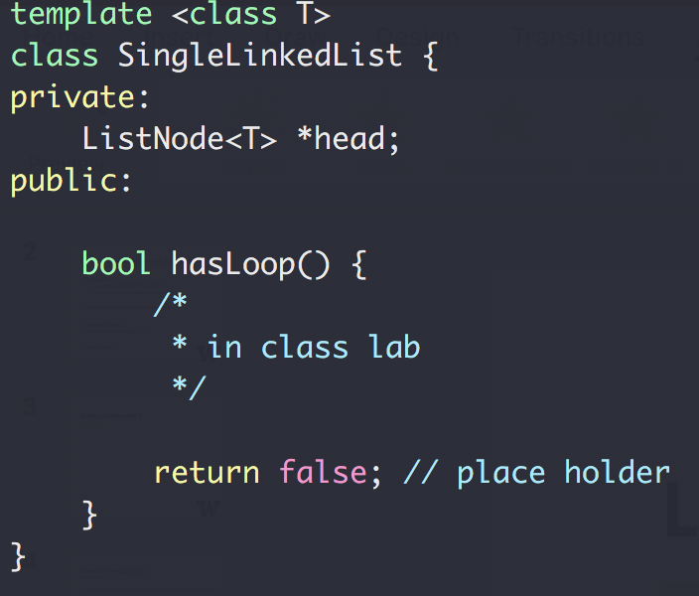
Linked List in-class lab 2
Given the head pointer (assuming with dummy head node)
Find whether the list has a loop

Slide 10
Linked List in-class lab 2
Given the head pointer (assuming with dummy head node)
Find whether the list has a loop
p0
Head → 0 → 1 → 2 → 3 → 4 → 5
p1
7
7
6

Slide 11
Linked List in-class lab 2
Given the head pointer (assuming with dummy head node)
Find whether the list has a loop
p0
p0
p0
p0
p1
Head → 0 → 1 → 2 → 3 → 4 → 5
p1
p1
8
7
6
p1

Slide 12
ADT: Stack
Design a Stack ADT
First in, last out
Usage: reverse a list, and many others

Slide 13
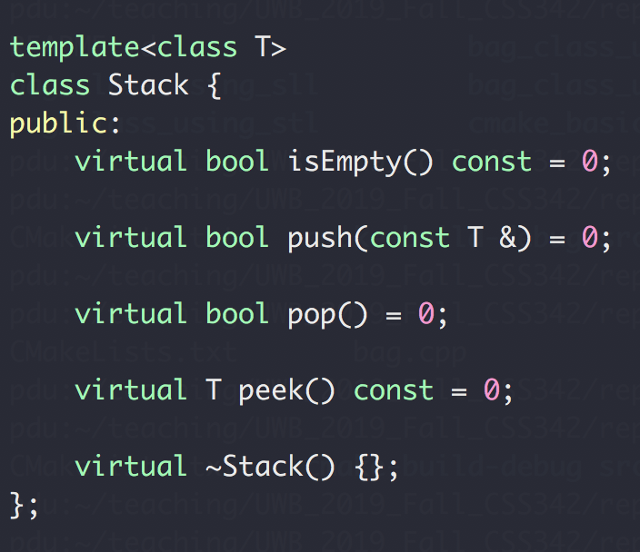
ADT Stack
Design a Stack ADT
First in, last out
Interface →

Slide 14
ADT Stack Exercise
Given a string containing just the characters '(', ')', '{', '}', '[' and ']', determine if the input string is valid.
An input string is valid if:
Open brackets must be closed by the same type of brackets
Open brackets must be closed in the correct order
An empty string is also considered valid.
https://leetcode.com/problems/valid-parentheses/

Slide 15
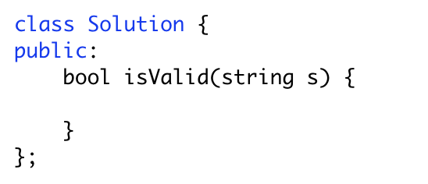
ADT Stack Exercise
Input: ( )
Output: true
Input: ( ]
Output: false
Output: true
Output: true
Input: ( ) [ ] { }
Output: true
Input: ( [ ) ]
Output: false
Input: { [ ] }
Output: true
Output: true
Output: true
Output: true

Slide 16
ADT Stack Exercise
Input: ( [ ] ) { }
push(‘(‘)
Stack: (

Slide 17
ADT Stack Exercise
Input: ( [ ] ) { }
push(‘[‘)
Stack: ( [

Slide 18
ADT Stack Exercise
Input: ( [ ] ) { }
pop (‘[‘)
Stack: (

Slide 19
ADT Stack Exercise
Input: ( [ ] ) { }
pop (‘(‘)
Stack:

Slide 20
ADT Stack Exercise
Input: ( [ ] ) { }
push(‘{‘)
Stack: {

Slide 21
ADT Stack Exercise
Input: ( [ ] ) { }
pop(‘}‘)
Stack:
STACK EMPTY ➔ return true

Slide 22
ADT Stack Exercise
https://www.geeksforgeeks.org/check-for-balanced-parentheses-in-an-expression/
Input: ( [ } ) { }
Stack: (
Stack: ( [
STACK not empty ➔ return false
Stack: ( [ }
Stack: ( [ } )
Stack: ( [ } ) {
Stack: ( [ } )

Slide 23
ADT Stack
Now let’s talk about implementation
Possible options?
Array
Primitive array T **
std::vector<T*>
Pros & cons?
List (single linked list)
Pros & cons?

Slide 24
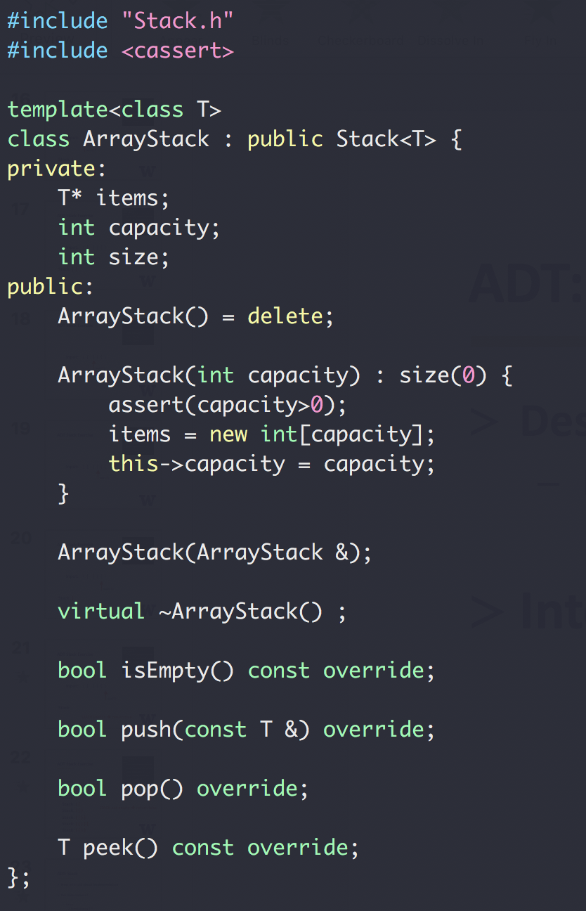
ADT Stack
Array Implement

Slide 25
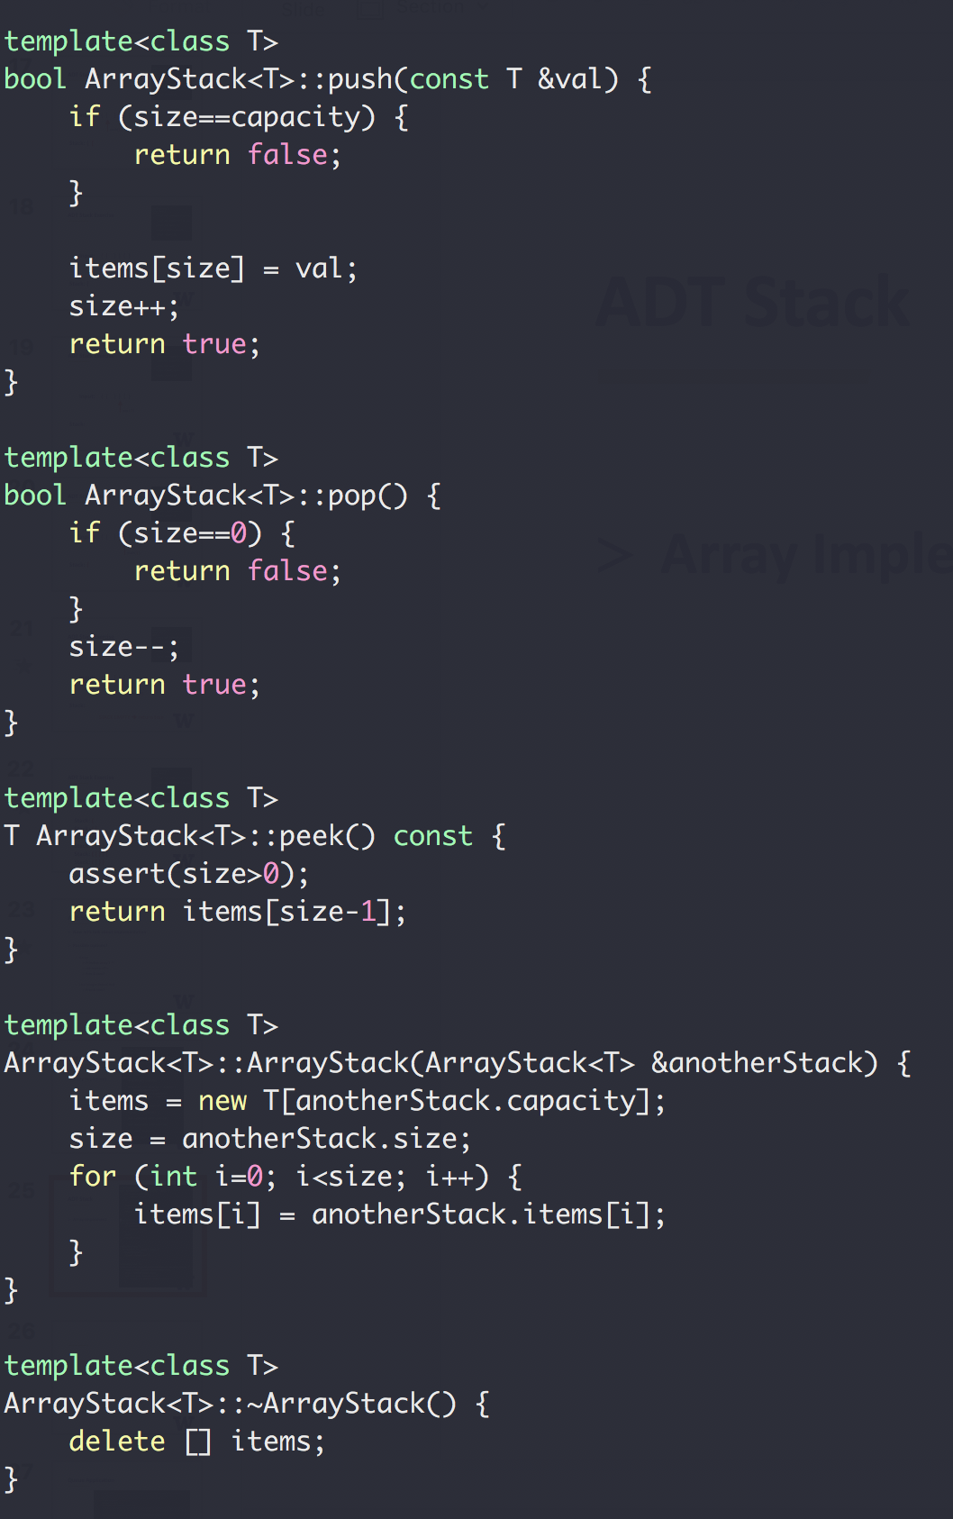
ADT Stack
Array Implement
PUSH
0 1 2 3
POP
0 1 2 3

Slide 26
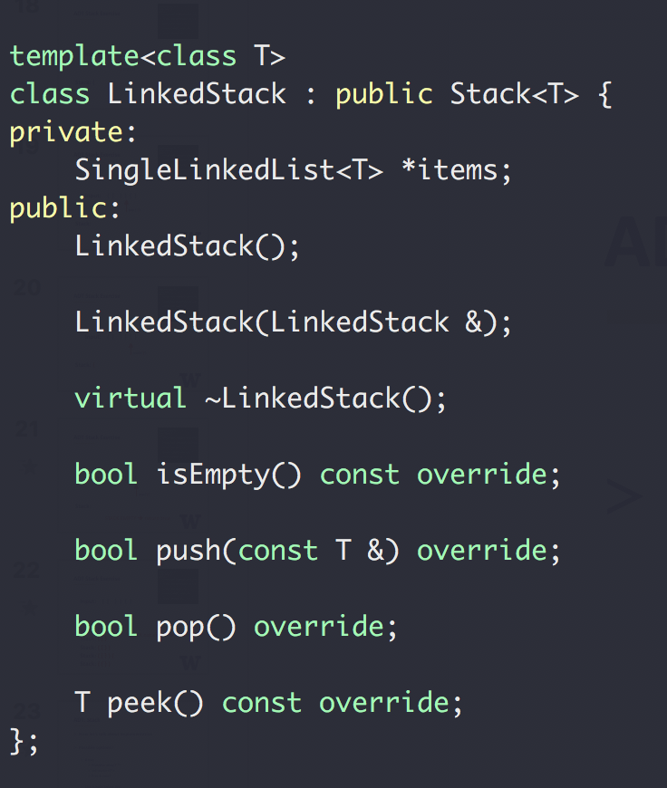
ADT Stack
Link Implement

Slide 27
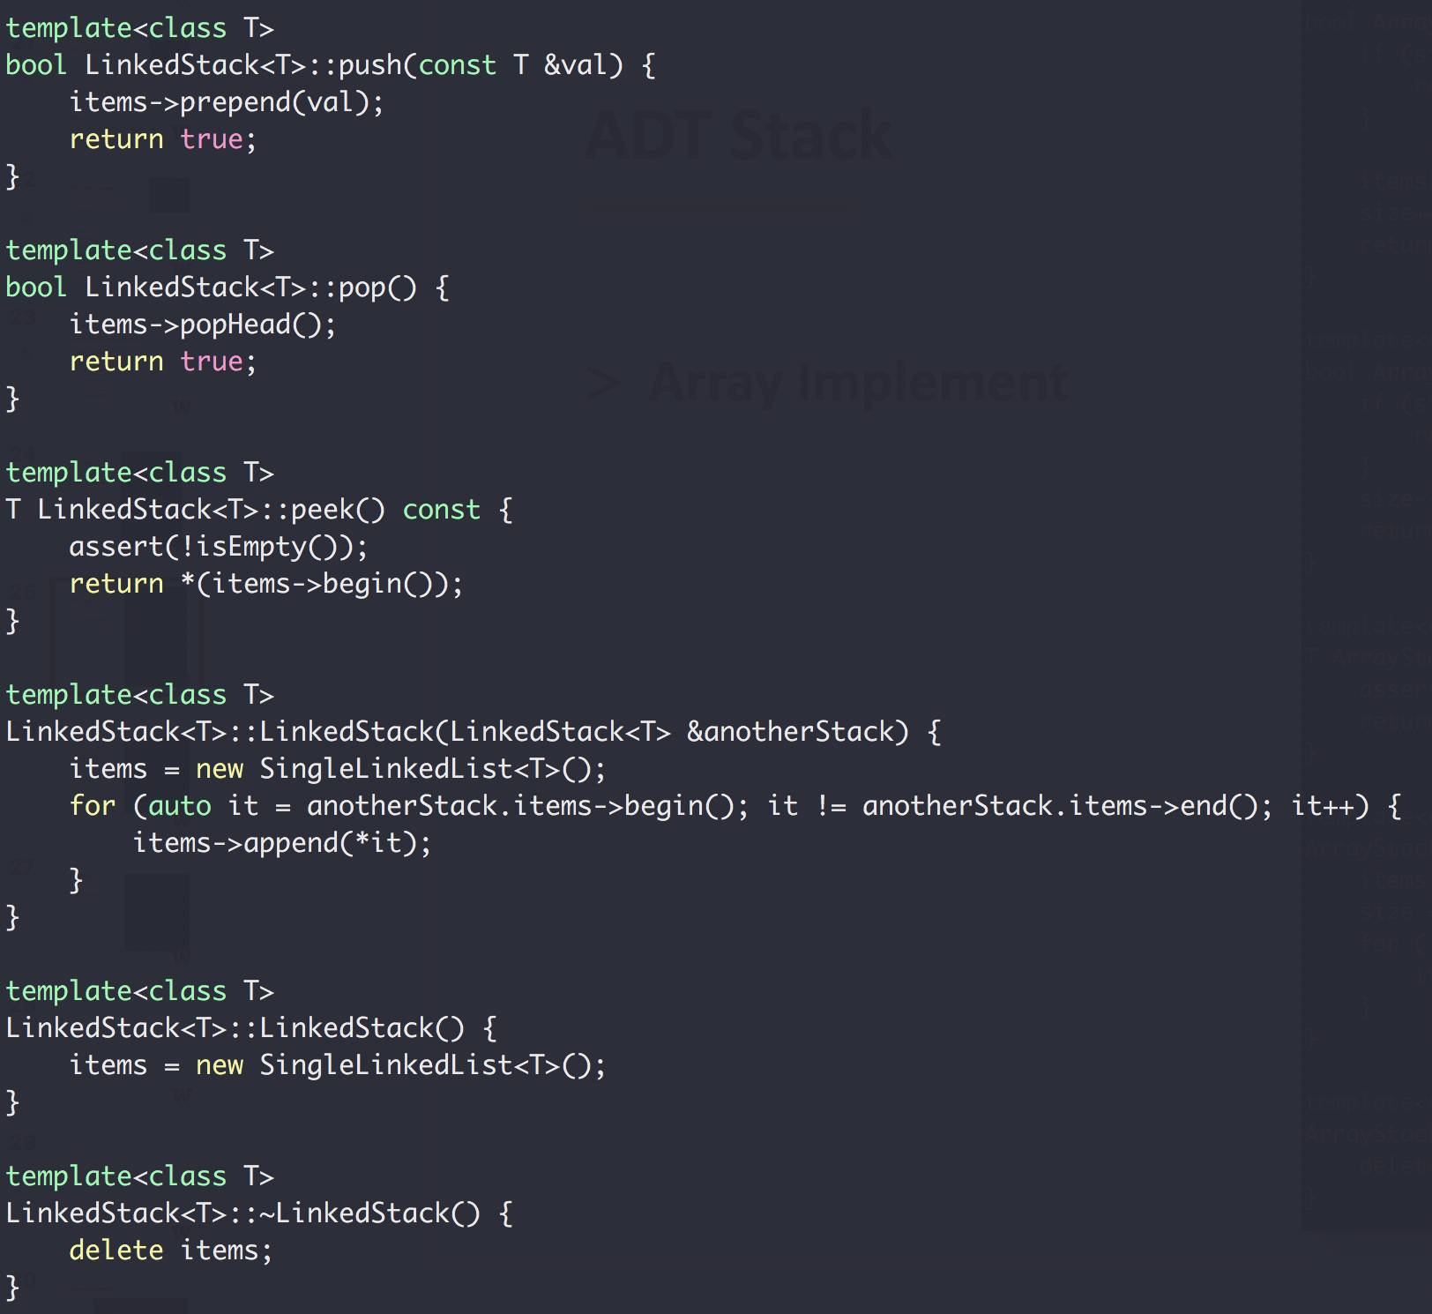

ADT Stack
val = 2
Next
head
val = 1
nullptr
Next
Next
Link
Implement
head
val = 1
val = 2
nullptr
Next
Next
Next

Slide 28
ADT: Queue
Design a Queue ADT
First in, first out (“first come, first serve”)
Usage: queueing scheduling system, message queue
Img: https://www.123rf.com/photo_52465854_stock-vector-passengers-in-queue-waiting-check-in-counters-at-airport.html

Slide 29
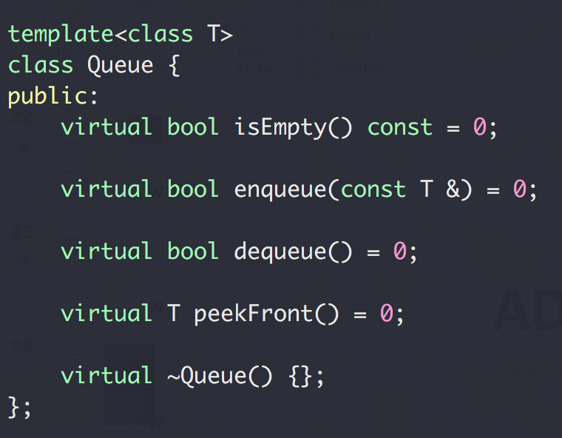
ADT Queue
Design a Queue ADT
First in, first out
Interface →

Slide 30
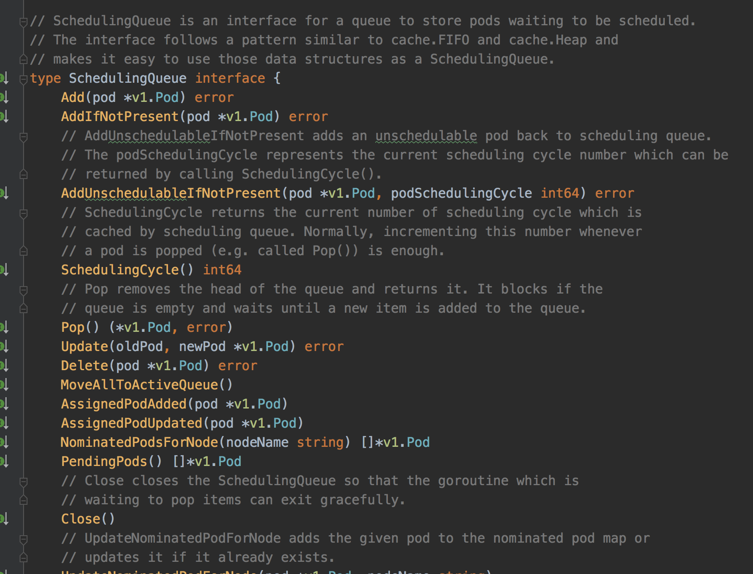
Queue example: Kubernetes Scheduler
pod
pod
pod
pod
pod
pod
pod
pod
Pod Queue
pod
pod
pod
pod
pod
pod
pod
pod
Scheduler
https://github.com/kubernetes/kubernetes

Slide 31
Queue Example: In the Linux Network Stack
Between the IP stack and the network interface controller (NIC) lies the driver queue.
This queue is typically implemented as a first-in, first-out (FIFO) ring buffer – just think of it as a fixed sized buffer.
The driver queue does not contain packet data. Instead it consists of descriptors which point to other data structures called socket kernel buffers (SKBs) which hold the packet data and are used throughout the kernel.
https://www.coverfire.com/articles/queueing-in-the-linux-network-stack/

Slide 32
Queue example: CPU Job Scheduling
Multiple-level queue scheduling
CPU BURST
I/O

Slide 33
Another Queue example
Priority Queue
Multiple-level queue scheduling
1 sec
2 sec
CPU
4 sec
8 sec
Only run tasks from a lower level queue if higher level queues are empty

Slide 34
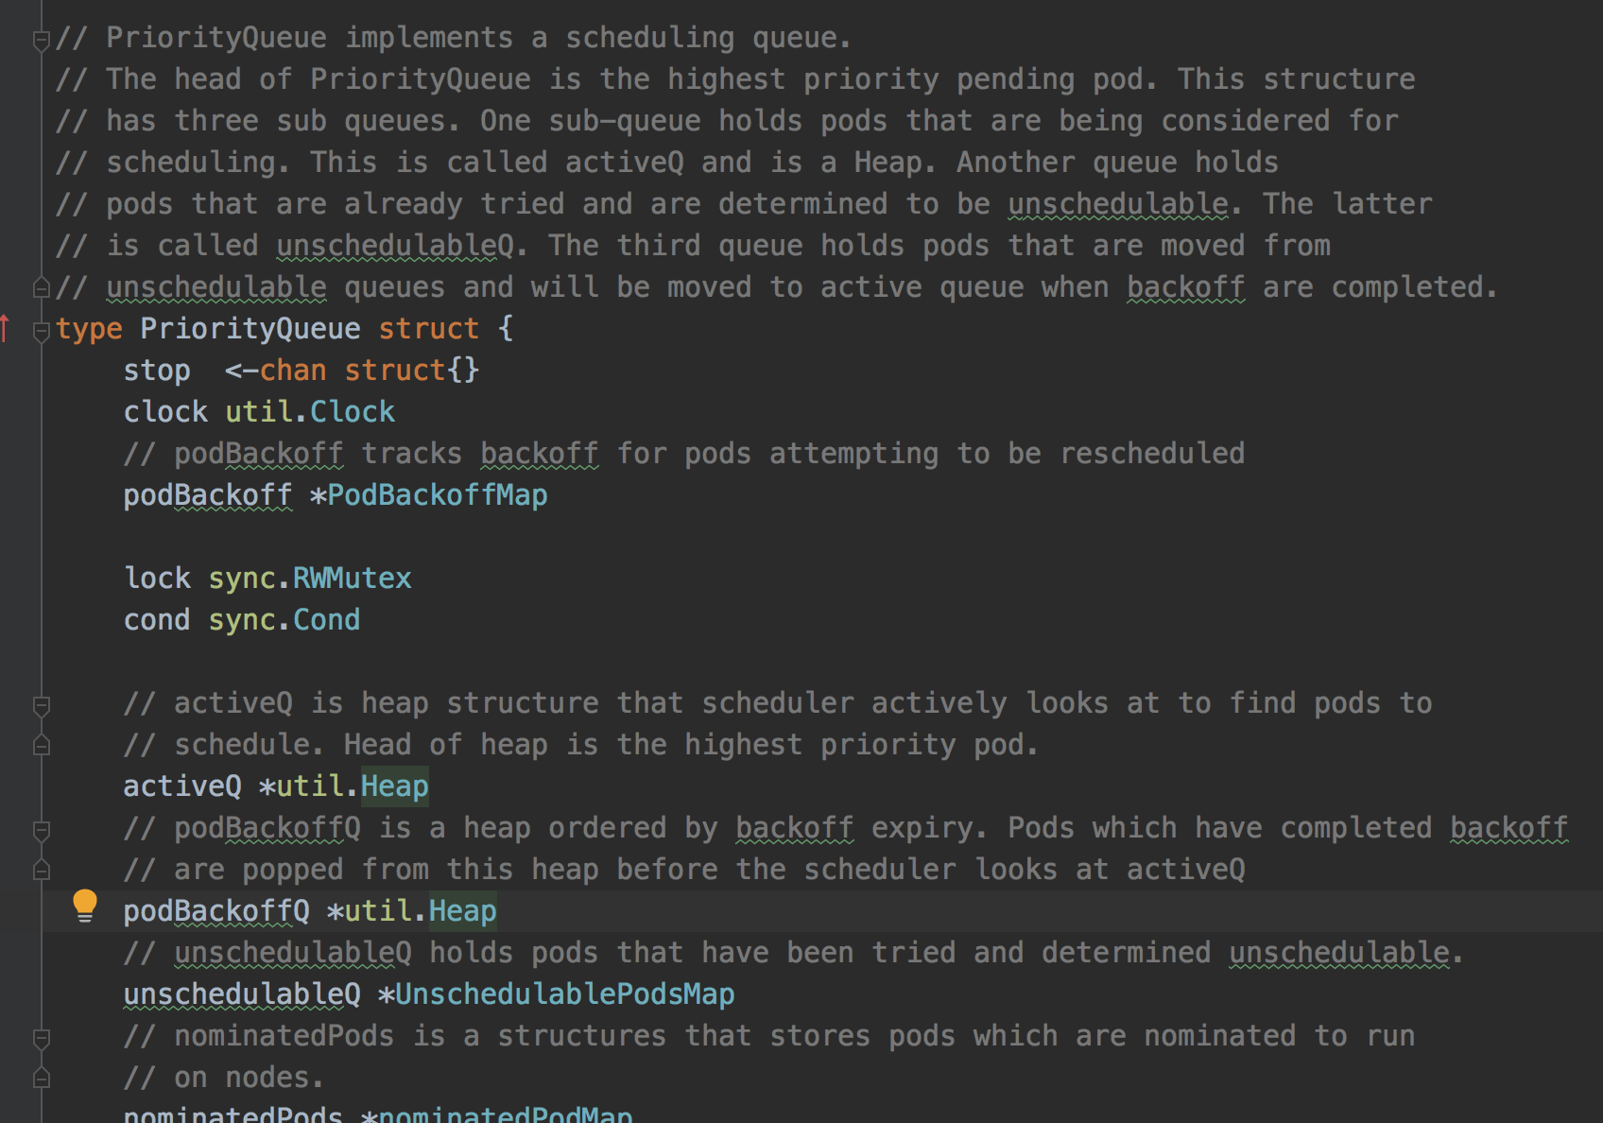
Another (Priority) Queue Example (also in K8s)
https://github.com/kubernetes/kubernetes/blob/master/pkg/scheduler/internal/queue/scheduling_queue.go#L112

Slide 35
ADT Queue
Now let’s talk about implementation
Possible options?
Array
Primitive array T **
std::vector<T*>
Pros & cons?
List (single linked list)
Pros & cons?

Slide 36
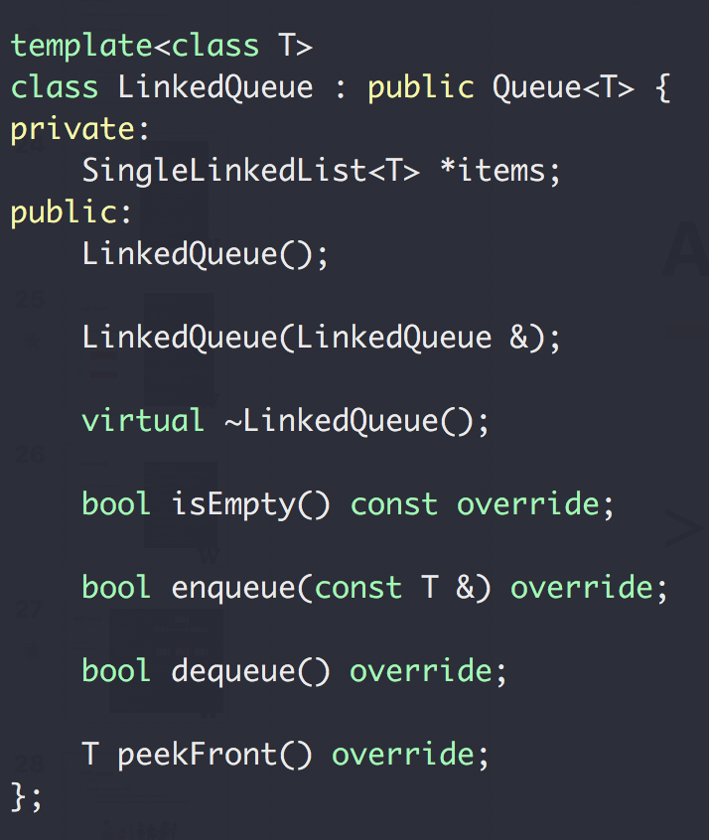
ADT Queue
Link Implement

Slide 37
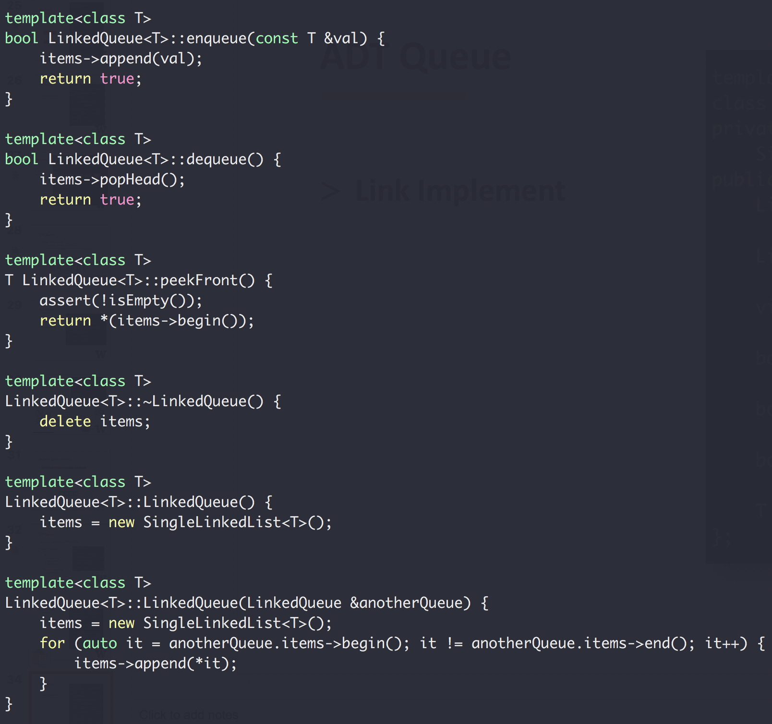

ADT Queue
val = 1
val = 2
val = 3
end
Next
Next
Next
Link
Implement
val = 1
val = 2
val = 3
end
Next
Next
Next

Slide 38
ADT Queue
Array Implement
enqueue
1
2
3
4
5
dequeue

Slide 39
ADT Queue
Array Implement
1
2
3
4
5
dequeue()
2
3
4
5
dequeue()
3
4
5
enqueue(6)
3
4
5
6
enqueue(7)
3
4
5
6
???

Slide 40
ADT Queue
Array Implement
1
2
3
4
5
dequeue()
2
3
4
5
dequeue()
3
4
5
enqueue(6)
3
4
5
6
enqueue(7)
7
3
4
5
6
enqueue(8)
7
8
3
4
5
6
Full!

Slide 41
ADT Queue
Array Implement
enqueue(6)
3
4
5
6
enqueue(7)
7
3
4
5
6
enqueue(8)
7
8
3
4
5
6
Full!
dequeue()
7
8
4
5
6
dequeue() x 4
8/8
dequeue()
empty

Slide 42
ADT Queue
Array Implement
frontIdx
https://hyperskill.org/learn/step/5355
2
3
4
5
endIdx

Slide 43
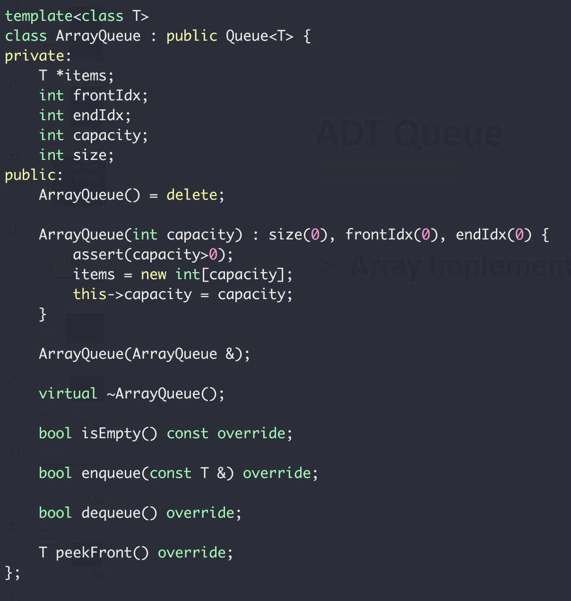
ADT Queue
Array Implement

Slide 44
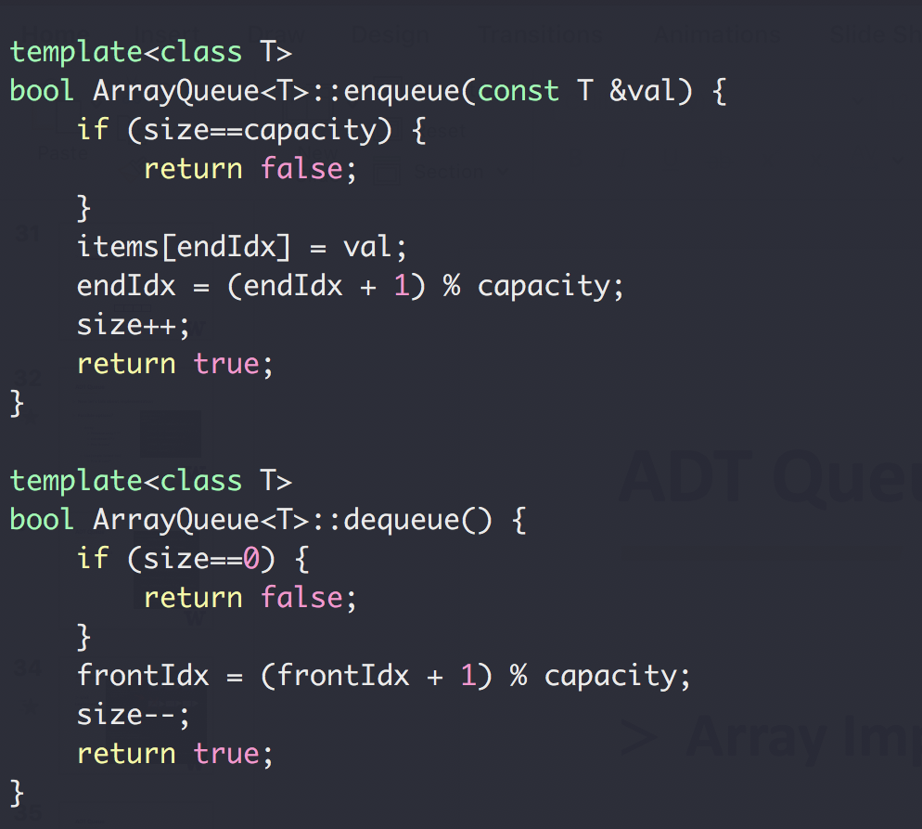
ADT Queue
Array Implement
0 % 4 = 0
1 % 4 = 1
2 % 4 = 2
3 % 4 = 3
4 % 4 = 0
5 % 4 = 1
6 % 4 = 2
… …
C++ mod(%) operator

Slide 45
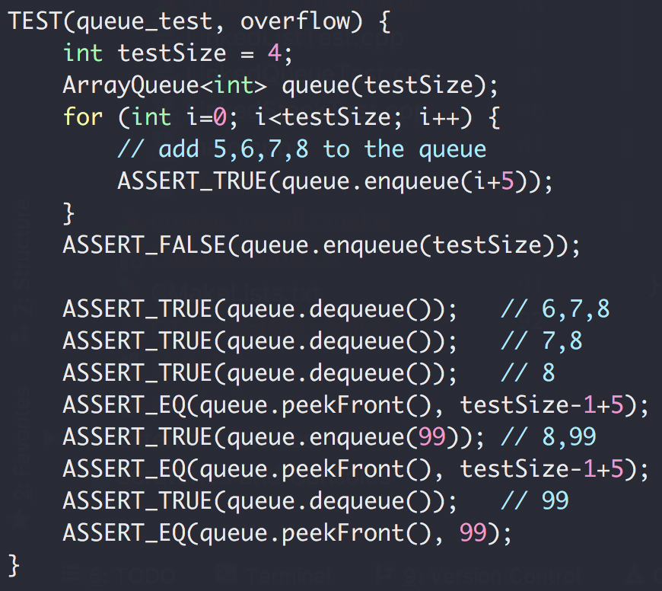
ADT Queue
Array queue test

Slide 46
ADT Queue
Array queue test
5
6
7
8
dequeue()
6
7
8
dequeue()
7
8
dequeue()
8/8
enqueue(99)
99
8
dequeue()
99/99

